Slide 1
Warm – Up: Find the following
$$y=2^{x−3}+1$$

Slide 2
Exponential Growth & Decay

Slide 3
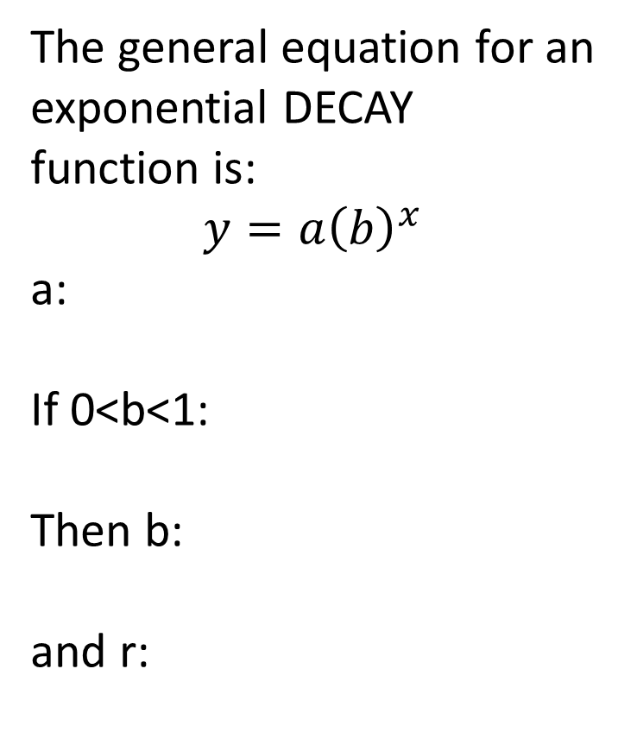
Parts of an Exponential Function
The general equation for an exponential GROWTH function is:
$$y=a{\left(b\right)}^{x}$$
a:
If b>1:
Then b:
and r:
The general equation for an exponential DECAY function is:
$$y=a{\left(b\right)}^{x}$$
a:
If 0<b<1:
Then b:
and r:

Slide 4
Examples:
Identify the initial value, the growth or decay factor, and the growth or decay rate of the exponential function.
$y=3{\left(1.8\right)}^{x}$
2. $y=2.1{\left(1.04\right)}^{x}$
Growth or decay:
Initial Value:
Growth or Decay factor:
Growth or Decay rate:
Growth or decay:
Initial Value:
Growth or Decay factor:
Growth or Decay rate:

Slide 5
Example:
$y=9{\left(.8\right)}^{x}$
Growth or decay:
Initial Value:
Growth or Decay factor:
Growth or Decay rate:

