Slide 1
Warm up
Solve.
1.
40°
x
4x – 20°
2.
2y + 28°
42°
3y – 14°

Slide 2
Congruent Triangles
Congruent triangles have 3 congruent sides and 3 congruent angles.
The parts of congruent triangles that “match” are called corresponding parts.

Slide 3
Congruence Statement
In a congruence statement
ORDER MATTERS!!!!
Everything matches up.

Slide 4
CPCTC
Corresponding Parts of Congruent Triangles are Congruent

Slide 5
Complete each congruence statement.
If ΔABC ≅ ΔDEF,
then BC ≅ ___
EF

Slide 6
Complete each congruence statement.
If ΔABC ≅ ΔDEF,
then ∠A ≅ ___
∠D

Slide 7
Fill in the blanks
If ΔCAT ≅ ΔDOG,
then AC ≅ ___
OD

Slide 8
Fill in the blanks
ΔBAT ≅ ΔMON
∠N
∠T ≅ ___
_____ ≅ ∠ONM
_____ ≅ MO
NM ≅ ____
∠ATB
BA
TB

Slide 9
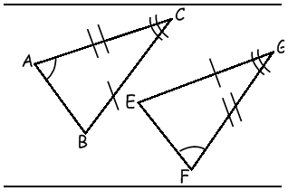
Fill in the blanks
ΔBCA ≅ Δ ____
Δ____ ≅ Δ GFE
EGF
CAB

Slide 10
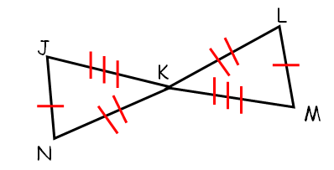
Complete the congruence statement.
MKL
Δ_____ ≅ Δ JKN

Slide 11
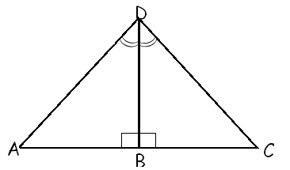
Complete the congruence statement.
ABD
Δ_____ ≅ Δ CBD

Slide 12
There are 5 ways to prove triangles congruent.

Slide 13
Side-Side-Side (SSS) Congruence Postulate
All Three sides in one triangle are congruent to all three sides in the other triangle

Slide 14
Side-Angle-Side (SAS) Congruence Postulate
Two sides and the INCLUDED angle
(the angle is in between the 2 marked sides)

Slide 15
Angle-Angle-Side (AAS) Congruence Postulate
A
A
A
A
S
S
Two Angles and One Side that is NOT included

Slide 16
Angle-Side-Angle (ASA) Congruence Postulate
A
A
S
S
A
A
Two angles and the INCLUDED side
(the side is in between the 2 marked angles)

Slide 17
There is one more way to prove triangles congruent, but it’s only for RIGHT TRIANGLES…Hypotenuse Leg
HL

Slide 18
SSS
SAS
ASA
AAS
HL
NO BAD WORDS
Your Only Ways To Prove Triangles Are Congruent

Slide 19
3 markings you can add if they aren’t marked already

Slide 20
Overlapping sides are congruent in each triangle by the REFLEXIVE property
Alt Int Angles are congruent given parallel lines
Vertical Angles are congruent

Slide 21
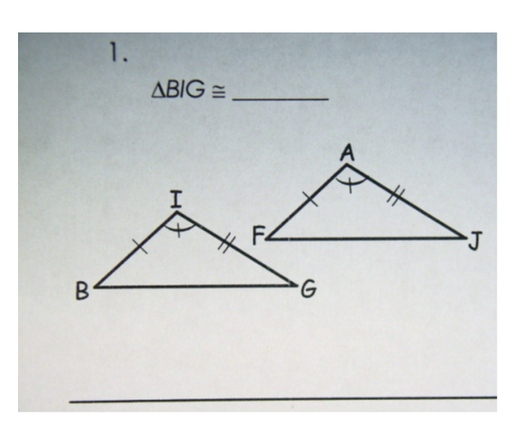
Practice

Slide 22
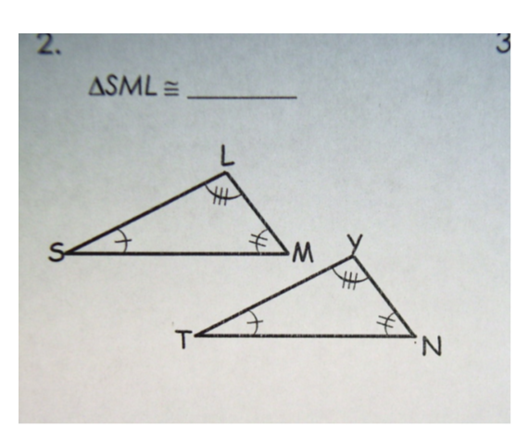
Practice

Slide 23
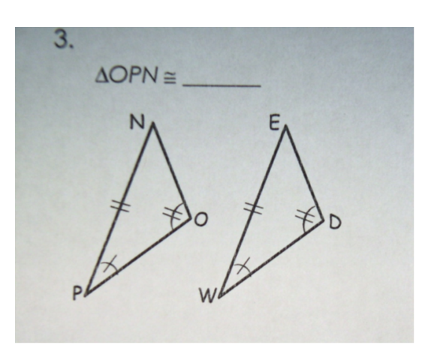
Practice

Slide 24
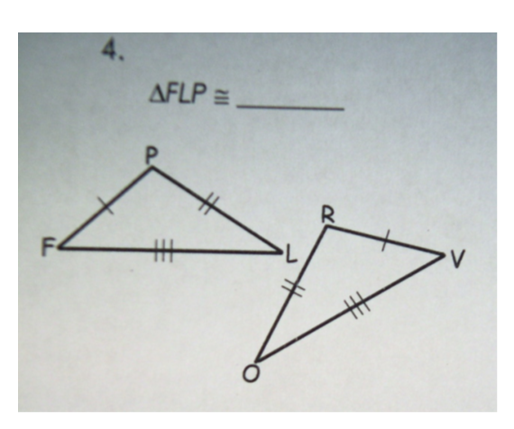
Practice

Slide 25
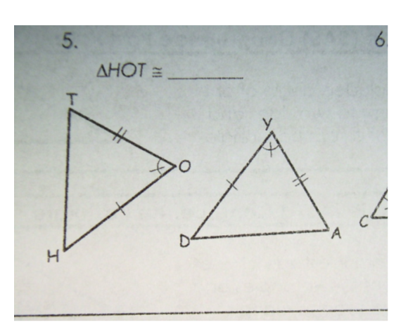
Practice

Slide 26
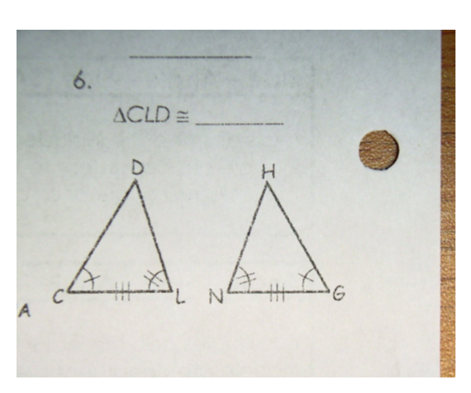
Practice

Slide 27
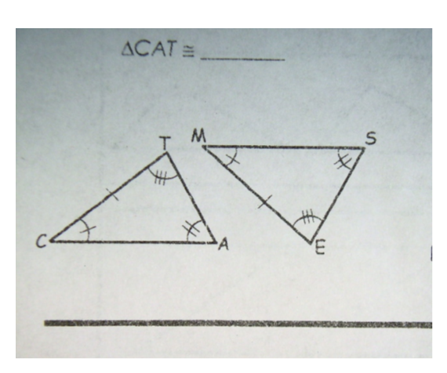
Practice

Slide 28
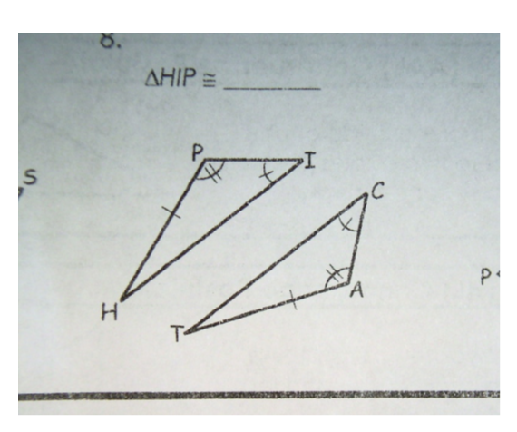
Practice

Slide 29
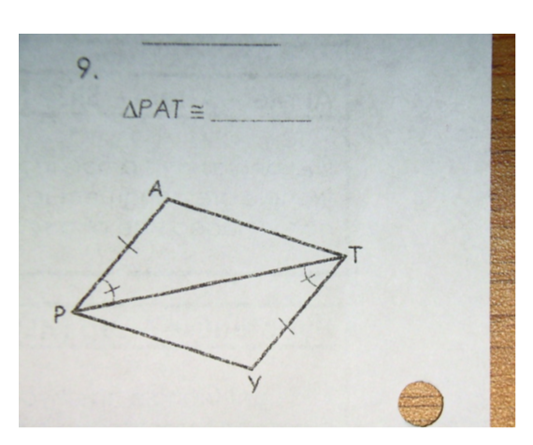
Practice

Slide 30
CW:
Practice Worksheet

Slide 31
Homework WS

