Slide 1
Warm – Up
Find the Volume:
Triangular Pyramid Base Area = 15 m² Height = 20 m
2) Find the radius:

Slide 2
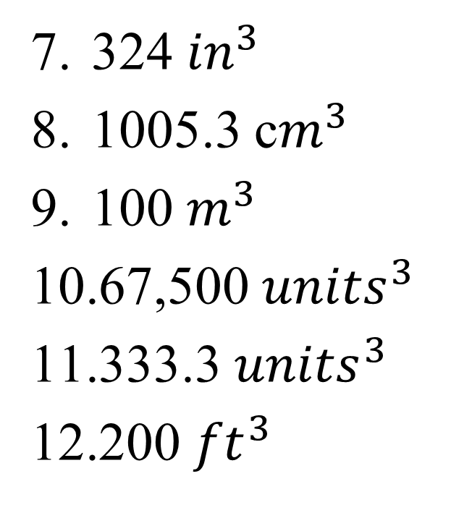
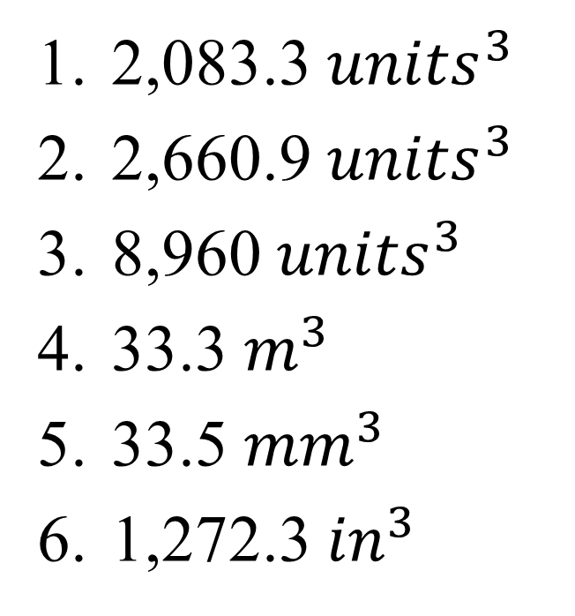
Homework Answers – Volume of Pyramids & Cones
2,083.3 ${units}^{3}$
2,660.9 ${units}^{3}$
8,960 ${units}^{3}$
33.3 $m^{3}$
33.5 ${mm}^{3}$
1,272.3 ${in}^{3}$
324 ${in}^{3}$
1005.3 c$m^{3}$
100 $m^{3}$
67,500 ${units}^{3}$
333.3 ${units}^{3}$
200 ${ft}^{3}$
4 cm
22.4 in
10 ft

Slide 3
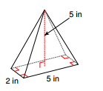
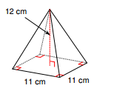
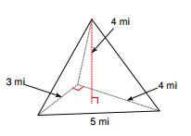
Find the Volume of the following Pyramids
1.
2.
3.
4.
A square pyramid measuring 10 yd along each edge of the base with a height of 6 yd.

Slide 4
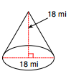
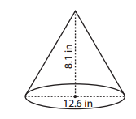
Find the Volume of the following Cones (Round to the nearest tenth)
1.
2.
4.
3. A cone with radius 4 m and a height of 12 m

Slide 5
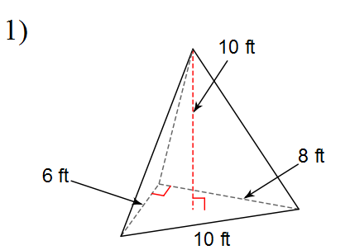
2) A conical beaker has a radius of 3.9 inches and a height of 12.5 inches. Find the volume of the beaker
Ticket Out the Door

Slide 6
Homework
Worksheet

