Slide 1
Equations of Circles

Slide 2
Standard Form of a Circle
Center is at (h, k)
r is the radius of the circle

Slide 3
General Form of a Circle
Every binomial squared has been multiplied out.
Every term is on the left side, equal to 0.

Slide 4
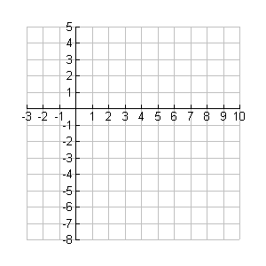
EX 1 Write an equation of a circle with center (3, -2) and a radius of 4.
h
k
r

Slide 5
EX 2 Write an equation of a circle with center (-4, 0) and a diameter of 10.
h
k
2r

Slide 6
EX 3 Write an equation of a circle with center (2, -9) and a radius of .
h
k
r

Slide 7
EX 4 Find the coordinates of the center and the measure of the radius.
Opposite signs!
( , )
6
-3
Take the square root!
Radius 5

Slide 8
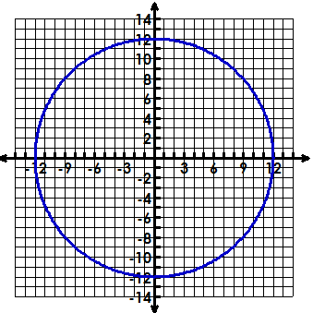
5. Find the center, radius, & equation of the circle.
The center is
The radius is
The equation is
(0, 0)
12
x² + y² = 144

Slide 9
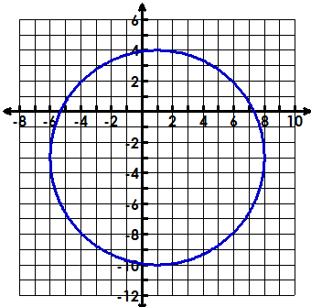
6. Find the center, radius, & equation of the circle.
The center is
The radius is
The equation is
(1, -3)
7
(x – 1)² + (y + 3)² = 49

Slide 10
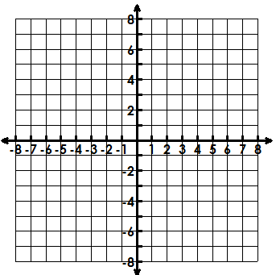
7. Graph the circle, identify the center & radius.
(x – 3)² + (y – 2)² = 9
Center (3, 2)
Radius of 3

Slide 11
HW
Worksheet:
#1 - #6

Slide 12
Warm – Up
Find the coordinates of the center and the measure of the radius.
Write an equation of a circle with center (4, -3) and a radius of 5

Slide 13
Matching Activity
Use the equations to help you match up the center and radius of each circle.
Write the number in each box that corresponds to the center and radius.
Any empty boxes, write the equation of the circle, given the center and radius.

Slide 14
Answers to Matching Activity
 | Center (2,1) | Center (2,-1) | Center (0,-2) | Center (-2,1)
Radius $\sqrt{5}$ | 4 | 11 | $$x^{2}+{(y+1)}^{2}=5$$ | $${(x+2)}^{2}+{(y−1)}^{2}=5$$
Radius$\sqrt{10}$ | 7 | 10 | 9 | 5
Radius 5 | 1 | 12 | 3 | $${(x+2)}^{2}+{(y−1)}^{2}=25$$
Radius 10 | $${(x−2)}^{2}+{(y−1)}^{2}=100$$ | 8 | 6 | 2

Slide 15
Converting from General to Standard
Move the x terms together and the y terms together.
Move C to the other side of the equals sign.
Complete the square (as needed) for x.
Complete the square(as needed) for y.
Factor the left & simplify the right.

Slide 16
8. Write the standard equation of the circle. State the center & radius.
Center: (4, 0) radius: 3

Slide 17
9. Write the standard equation of the circle. State the center & radius.
Center: (-2, 3) radius: 4

Slide 18
10. Write the standard equation of the circle. State the center & radius.

Slide 19
11. Write the general form of the equation of the circle.

Slide 20
Homework
Worksheet: #1 - #15

Slide 21
Warm - Up
A circular disk drive has a diameter with endpoints at (−9, 2) and (15, 12). Find the center and radius of the disk drive. Write the equation of the circle in standard form.

Slide 22
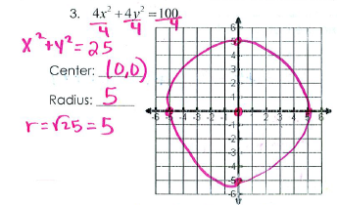
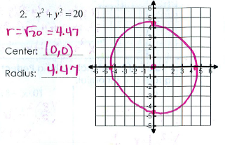
Homework Answers

Slide 23
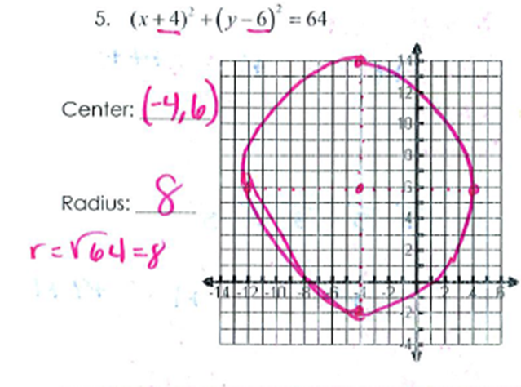
Homework Answers

Slide 24
Homework Answers
7. $x^{2}+y^{2}−4x −6y+9=0$
8. $x^{2}+y^{2}+2x+4y−4=0$
9. ${(x−3)}^{2}$
10. ${(x+4)}^{2}$
11. ${(x − \frac{7}{2})}^{2}$
12. ${(x+1)}^{2}+{(y −5)}^{2}=16;$Center: (-1,5) Radius: 4
13. ${(x−2)}^{2}+{(y+3)}^{2}=4;$Center: (2, -3) Radius: 2
14. ${(x−5)}^{2}+{(y−6)}^{2}=21;$ Center: (5, 6) Radius: 4.6
15. ${(x−2)}^{2}+{(y+1)}^{2}=4;$ Center: (2, -1) Radius: 2

Slide 25
Does the point lie on the circle?
Complete Task

